Slide 1


Bangalore Institute of Technology
K.R. Road, V.V. Pura, Bengaluru.-560004.
Department of Information Science & Engineering
“Cataract Eye Detection Using Machine Learning”
Presented by
1BI20IS005-ADITHYA KUMAR C S Under the Guidance of
1BI20IS011-ALOK SHETTY Chethana M
1BI20IS035-INDRAJITH N Assistant Professor
1BI20IS045-KEERTHAN SHETTY Dept. of Information Science and Engineering

Slide 2
Bangalore Institute of Technology
K.R. Road, V.V. Pura, Bengaluru.-560004.
Department of Information Science & Engineering
Agenda
Introduction
Literature Survey
Existing Systems
Problem Statement
Proposed System
Project Planning
Sample Dataset
Applications
References

Slide 3
Bangalore Institute of Technology
K.R. Road, V.V. Pura, Bengaluru.-560004.
Department of Information Science & Engineering
Introduction
Cataracts, causing lens cloudiness, pose a threat to vision and may lead to blindness.
Lens transparency relies on microscopic factors, and aging introduces yellow-brown pigments, affecting light entry.
Gradual symptoms include pale colors, blurry vision, light haloing, light sensitivity, and difficulty seeing in the dark.

Slide 4
Bangalore Institute of Technology
K.R. Road, V.V. Pura, Bengaluru.-560004.
Department of Information Science & Engineering
Objectives
Collection of ASPI data set from hospitals and other sources
Data preprocessing
Building machine learning model to evaluate data
Front-end development for getting images from the file manager/ direct image capturing.
Recommendation system for cataract conclusion and further suggestion based on the result obtained.

Slide 5
Bangalore Institute of Technology
K.R. Road, V.V. Pura, Bengaluru.-560004.
Department of Information Science & Engineering
Literature Survey
PAPER- 1
Title: Identification and Classification of Cataract Stages in Old Age People Using Deep Learning Algorithm.
Authors: Sahana M, Gowrishankar S
Year: 2019(IJITEE)
Proposed Idea: The proposed idea mentioned in the document is to use a deep learning algorithm for the identification and classification of cataract stages in old age people.

Slide 6
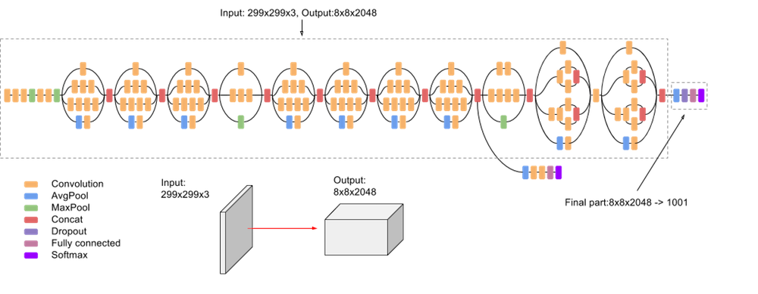
Bangalore Institute of Technology
K.R. Road, V.V. Pura, Bengaluru.-560004.
Department of Information Science & Engineering
The algorithm utilizes a convolutional neural network (CNN) for feature extraction and classification of cataract images.
Architecture

Slide 7
Bangalore Institute of Technology
K.R. Road, V.V. Pura, Bengaluru.-560004.
Department of Information Science & Engineering
Methodology
The study used a deep learning algorithm and transfer learning methodology to identify and classify cataract stages in old age people.
The Squeeze Net model was employed for cataract classification and detection. The dataset was preprocessed to remove noise, and the Hough Circle algorithm was used to detect the circular part of the cataract in the images.
The model was built using a convolutional neural network, and features were extracted using the maximum entropy method and the Caffe framework. Softmax and support vector machine algorithms were used for cataract classification.

Slide 8
Bangalore Institute of Technology
K.R. Road, V.V. Pura, Bengaluru.-560004.
Department of Information Science & Engineering
Limitations
Limited data availability for old age people
Ethnic and demographic variability

Slide 9
Bangalore Institute of Technology
K.R. Road, V.V. Pura, Bengaluru.-560004.
Department of Information Science & Engineering
PAPER- 2
Title: Automatic Detection of Eye Cataract using Deep Convolution Neural Networks
Authors: Md. Rajib Hossain, Sadia Afroze, Nazmul Siddique
Year: 2020(IEEE)
Proposed Idea: The proposed idea for developing an automatic cataract detection system using Deep Convolution Neural Networks (DCNNs) is to train a DCNNs model with labeled data sets of retinal fundus images. The DCNNs model, based on Res-Net50 architecture, is trained to detect cataract and non-cataract images.

Slide 10
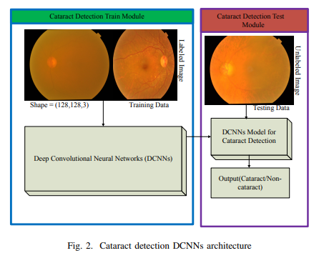
Bangalore Institute of Technology
K.R. Road, V.V. Pura, Bengaluru.-560004.
Department of Information Science & Engineering
Architecture

Slide 11
Bangalore Institute of Technology
K.R. Road, V.V. Pura, Bengaluru.-560004.
Department of Information Science & Engineering
Methodology
The DCNNs model, based on Res-Net50 architecture, is trained to detect cataract and non-cataract images. The system consists of two modules: a training module and a testing module. The training module uses supervised DCNNs algorithm to train the model withlabeled data, while the testing module tests the model with unlabeled data to detect cataract.

Slide 12
Bangalore Institute of Technology
K.R. Road, V.V. Pura, Bengaluru.-560004.
Department of Information Science & Engineering
Limitations
Partial/mild cataracts challenging
Pre-processing overlooked
Image prep unaddressed

Slide 13
Bangalore Institute of Technology
K.R. Road, V.V. Pura, Bengaluru.-560004.
Department of Information Science & Engineering
PAPER- 3
Title: Unified Diagnosis Framework for Automated Nuclear Cataract Grading Based on Smartphone Slit-Lamp Images.
Authors: Iaoting Wang , Hong Wu
Year: 2020(IEEE)
Proposed Idea: The proposed idea in the document is to develop a cataract severity classification algorithm based on deep learning. The algorithm aims to automate the detection and classification of cataracts in the anterior eye using artificial intelligence.

Slide 14
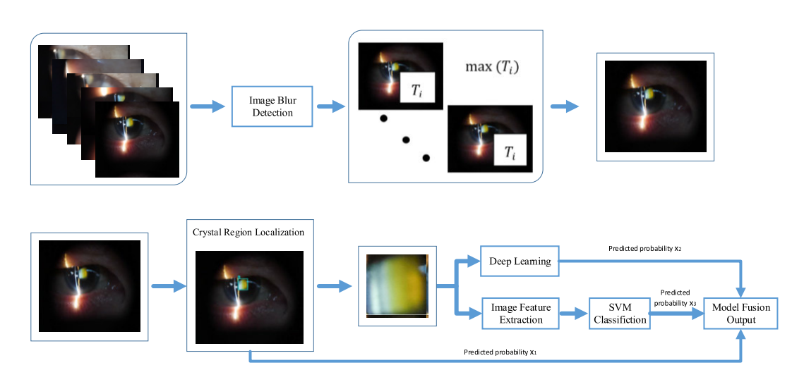
Bangalore Institute of Technology
K.R. Road, V.V. Pura, Bengaluru.-560004.
Department of Information Science & Engineering
The framework integrates three different artificial intelligence networks to improve the accuracy of diagnosis and reduce false positives.
Architecture

Slide 15
Bangalore Institute of Technology
K.R. Road, V.V. Pura, Bengaluru.-560004.
Department of Information Science & Engineering
Methodology
YOLOv3 locates lens nuclear region for cataract classification.
Shufflenet extracts lens appearance, aids cataract severity classification.
SVM grades cataract severity using extracted features dataset.
819 images evaluated; accuracy, Kappa, F1, AUC calculated.

Slide 16
Bangalore Institute of Technology
K.R. Road, V.V. Pura, Bengaluru.-560004.
Department of Information Science & Engineering
Limitations
Limited Image Quality.
Variability in Image Acquisition.
Data Bias and Generalization.

Slide 17
Bangalore Institute of Technology
K.R. Road, V.V. Pura, Bengaluru.-560004.
Department of Information Science & Engineering
PAPER- 4
Title: Artificial Intelligence for Cataract Detection and Management
Authors: Ayesha Anees, Yih-Chung Tham
Year: 2020(IEEE)
Proposed idea: The document explores AI applications in cataract diagnosis, emphasizing deep learning's accuracy in detecting and grading cataracts. It discusses AI's role in enhancing IOL power calculation, especially in complex cases, stressing the necessity for further research and real-world evaluations.

Slide 18
Bangalore Institute of Technology
K.R. Road, V.V. Pura, Bengaluru.-560004.
Department of Information Science & Engineering
Methodology
The document discusses the application of artificial intelligence (AI) in cataract diagnosis and intraocular lens (IOL) power calculation. It mentions that AI algorithms have been developed for automated cataract assessment using slit lamp or color fundus photographs.
These algorithms analyze the images to detect the presence of cataract and evaluate its severity. Additionally, AI has the potential to improve IOL power calculation by unraveling complex relationships among ocular parameters.
Deep learning tailors eye-specific calculations, needing robust data and external validations for cataract algorithms.

Slide 19
Bangalore Institute of Technology
K.R. Road, V.V. Pura, Bengaluru.-560004.
Department of Information Science & Engineering
Limitations
Lack of robust, high-quality training data.
Lack of external validations.
Subjective ground truth data.
Challenges with atypical biometric profiles and past refractive surgery.

Slide 20
Bangalore Institute of Technology
K.R. Road, V.V. Pura, Bengaluru.-560004.
Department of Information Science & Engineering
PAPER- 5
Title: CataractNet: An Automated Cataract Detection System Using Deep Learning for Fundus Images
Authors: Masum shah junayed, Md baharul islam, Arezoo sadeghzadeh, and Saimunur rahman.
Year: 2021(IEEE)
Proposed Idea:The proposed idea is to the develop a deep learning system called CataractNet for automated cataract detection in fundus images.

Slide 21
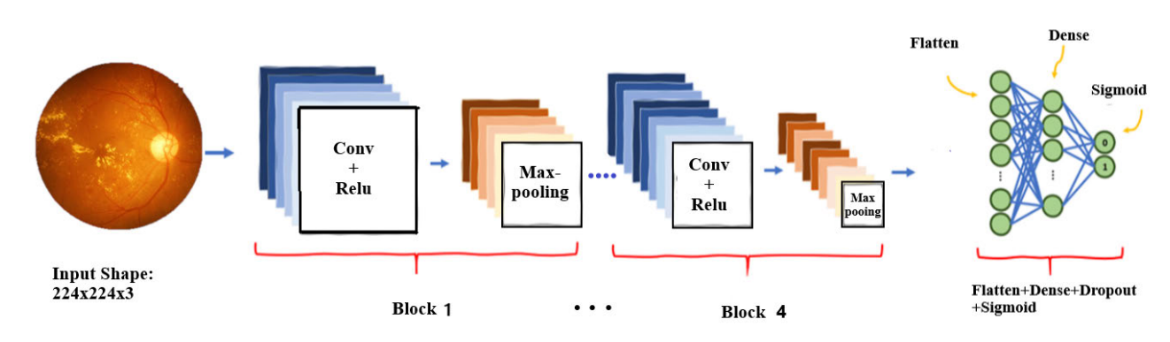
Bangalore Institute of Technology
K.R. Road, V.V. Pura, Bengaluru.-560004.
Department of Information Science & Engineering
CataractNet is a Convolutional Neural Network (CNN) that integrates the feature extraction phase and the classification process into a single model. This network is designed to detect cataracts in fundus images. The system consists of three main steps: pre-processing, feature extraction, and classification.
Architecture

Slide 22
Bangalore Institute of Technology
K.R. Road, V.V. Pura, Bengaluru.-560004.
Department of Information Science & Engineering
Methodology
Dataset Preparation: A dataset of fundus images is collected from various sources, including publicly available databases and data augmentation techniques.
Cataract Detection Model: A 16-layer deep learning neural network called CataractNet is proposed for cataract detection. The number of layers, activation functions, and loss functions are tuned to improve the detection accuracy.
Comparison with Other Models: Five other CNN models (VGG-16, VGG-19, MobileNet, Inception-v3, and ResNet-50) are implemented to compare and demonstrate the capability and accuracy of CataractNet.

Slide 23
Bangalore Institute of Technology
K.R. Road, V.V. Pura, Bengaluru.-560004.
Department of Information Science & Engineering
Limitations
Limited Cataract Differentiation
Lack of Grading Precision

Slide 24
Bangalore Institute of Technology
K.R. Road, V.V. Pura, Bengaluru.-560004.
Department of Information Science & Engineering
PAPER- 6
Title: Cataract Disease Detection by Using Transfer Learning-Based Intelligent Methods
Authors: Md Kamrul Hasan, Tanjum Tanha
Year: 2021(Hindavi)
Proposed idea:The study employs CNNs, specifically InceptionResNetV2, for cataract classification using a public dataset. The focus is on transfer learning techniques for early cataract detection and prevention strategies.

Slide 25
Bangalore Institute of Technology
K.R. Road, V.V. Pura, Bengaluru.-560004.
Department of Information Science & Engineering
Methodology
The study aimed to detect cataract disease using transfer learning-based intelligent methods.
Four different deep learning models, namely DenseNet121, Xception, InceptionV3, and InceptionResNetV2, were compared for their performance in cataract disease detection.
The dataset used consisted of 1088 fundus pictures collected from various hospitals and medical institutions.

Slide 26
Bangalore Institute of Technology
K.R. Road, V.V. Pura, Bengaluru.-560004.
Department of Information Science & Engineering
Preprocessing techniques were applied to the dataset, including resizing the images to 224x224 pixels using OpenCV.
The best model, InceptionResNetV2, achieved high accuracy, sensitivity, and specificity in detecting cataract disease.
The study concluded that using intelligent methods based on transfer learning can aid in early detection and prevention of cataracts

Slide 27
Bangalore Institute of Technology
K.R. Road, V.V. Pura, Bengaluru.-560004.
Department of Information Science & Engineering
Limitations
Dataset Size and Diversity
Preprocessing Methods
Lack of External Validation

Slide 28
Bangalore Institute of Technology
K.R. Road, V.V. Pura, Bengaluru.-560004.
Department of Information Science & Engineering
PAPER- 7
Title: Cataract Detection using Deep Learning Model on Digital Camera Images
Authors: Raghavendra chaudhary, Arun kumar
Year: 2022(IEEE)
Proposed Idea: The proposed idea in the study is to develop a cataract detection system based on smartphone camera images. The study aims to provide a convenient and accessible method for detecting cataracts, especially for people living in rural areas who may not have easy access to ophthalmology imaging devices.

Slide 29
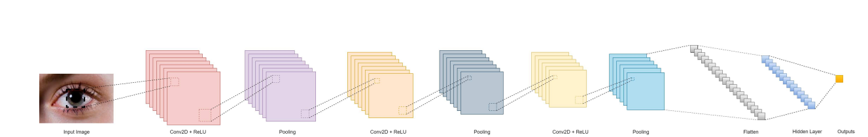
Bangalore Institute of Technology
K.R. Road, V.V. Pura, Bengaluru.-560004.
Department of Information Science & Engineering
The system utilizes deep learning models and image processing techniques to analyze the smartphone camera images and classify them for cataract detection.
Architecture

Slide 30
Bangalore Institute of Technology
K.R. Road, V.V. Pura, Bengaluru.-560004.
Department of Information Science & Engineering
Methodology
Dataset: The study uses a dataset collected by krishnabojha, which contains two classes - cataract and normal. The dataset consists of 9668 images, with 80% of the images used for training the model and 20% for testing.
Model Training: The proposed model is trained using deep learning algorithms. The study mentions the use of deep convolutional neural networks (CNN) for cataract detection.

Slide 31
Bangalore Institute of Technology
K.R. Road, V.V. Pura, Bengaluru.-560004.
Department of Information Science & Engineering
Model Evaluation: After training, the model is evaluated using the testing dataset. The accuracy of the model in detecting cataract images is measured based on the classification results.
Performance Analysis: The performance of the proposed model is analyzed based on various evaluation metrics such as accuracy, precision, recall, and F1-score. These metrics provide insights into the effectiveness of the model in detecting cataracts.

Slide 32
Bangalore Institute of Technology
K.R. Road, V.V. Pura, Bengaluru.-560004.
Department of Information Science & Engineering
Limitations
Limited Rural Ophthalmologists Access
Complex, Time-Intensive
Convenient but less accurate

Slide 33
Bangalore Institute of Technology
K.R. Road, V.V. Pura, Bengaluru.-560004.
Department of Information Science & Engineering
PAPER- 8
Title: Automatic Cataract Severity Detection and Grading Using Deep Learning
Authors:Sunita Yadav, Jay Kant Pratap SinghYadav
Year: 2023(Hindawi)
Proposed idea:The proposed method in this document is an automatic cataract detection and grading system using deep learning. It involves image acquisition, image quality selection, preprocessing, feature extraction, and classification. The method utilizes 2D-DFT spectrograms of fundus images and a convolutional neural network (CNN) to detect and classify cataracts into four classes.

Slide 34
Bangalore Institute of Technology
K.R. Road, V.V. Pura, Bengaluru.-560004.
Department of Information Science & Engineering
Methodology
Benchmark dataset: 1,835 retinal fundus images, randomly selected from public datasets and the internet, ensuring each class has 400+ images.
Module evaluates fundus image quality, selects high-quality images, ensuring accurate testing for model evaluation and reliability.
Selected fundus images undergo resizing, G-filtering, and normalization. Data augmentation generates extra samples, enhancing the proposed method's performance.
Preprocessed fundus images transformed into 2D-DFT spectrograms. Spectrograms capture blood vessel details, aiding cataract detection. CNN extracts features.

Slide 35
Bangalore Institute of Technology
K.R. Road, V.V. Pura, Bengaluru.-560004.
Department of Information Science & Engineering
Limitations
Manual Feature Extraction
Neglect of Tiny Blood Vessel Features
Computation Cost
Dependency on Extracted Features

Slide 36
Bangalore Institute of Technology
K.R. Road, V.V. Pura, Bengaluru.-560004.
Department of Information Science & Engineering
PAPER- 9
Title:Cataract Detection using Pupil Patch Classification and Ruled-based System in Anterior Segment Photographed Images
Authors: Aini Hussain , Laily Azyan Ramlan , Haliza Abdul Mutalib
Year: 2023(IEEE)
Proposed idea: The document suggests using smartphone-captured ASPIs for cataract screening. Preprocessing and transfer learning, specifically with ResNet-50, enhance the method's accuracy in cataract detection from digital images.

Slide 37
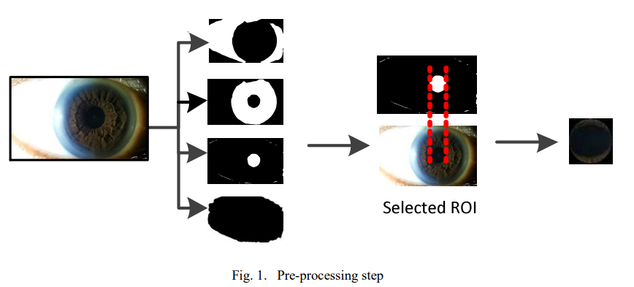
Bangalore Institute of Technology
K.R. Road, V.V. Pura, Bengaluru.-560004.
Department of Information Science & Engineering
Architecture

Slide 38
Bangalore Institute of Technology
K.R. Road, V.V. Pura, Bengaluru.-560004.
Department of Information Science & Engineering
Methodology
High-resolution Leica lens used for capturing ASPI data of cataracts and normal eyes via smartphone cameras for the study.
ASPIs were cropped, enhanced using MSRCP, and pupil images extracted for dataset training, ensuring focused and improved image quality.
Patch classification utilized transfer learning with networks like AlexNet, GoogLeNet, VGG16, Inceptionv3, and ResNet-50, employing 5-fold cross-validation for optimal cataract detection.

Slide 39
Bangalore Institute of Technology
K.R. Road, V.V. Pura, Bengaluru.-560004.
Department of Information Science & Engineering
Limitations
Poor image quality can affect the accuracy of cataract detection algorithms.
Inadequate lighting or excessive glare can make it challenging to detect cataracts accurately from digital images.
variability can affect the performance of cataract detection algorithms.
Lack of Clinical Context.

Slide 40
Bangalore Institute of Technology
K.R. Road, V.V. Pura, Bengaluru.-560004.
Department of Information Science & Engineering
PAPER- 10
Title: Automated cataract disease detection on anterior segment eye images using adaptive thresholding and fine tuned inception-v3 model
Authors:Sahil Faizal, Charu Anant Rajput
Year: 2023(Elsevier)
Proposed idea:This paper presents an algorithm for automated cataract disease detection using adaptive thresholding and a fine-tuned Inception-v3 model. The algorithm achieves a high classification accuracy of about 95% and is capable of detecting cataracts using both visible wavelength images and anterior segment images

Slide 41
Bangalore Institute of Technology
K.R. Road, V.V. Pura, Bengaluru.-560004.
Department of Information Science & Engineering
Methodology
The proposed methodology involves the use of adaptive thresholding and a fine-tuned Inception-v3 model for automated cataract disease detection.
The methodology includes dataset acquisition, image pre-processing techniques, and the architecture of the proposed model.
Specular reflection is removed using morphological dilation operation, and the region of interest (ROI) is segmented using Canny edge detection, Hough circle detection, and cropping.

Slide 42
Bangalore Institute of Technology
K.R. Road, V.V. Pura, Bengaluru.-560004.
Department of Information Science & Engineering
Limitations
Limited Imaging Modality
Overfitting Tendencies
Small and Uneven Dataset

Slide 43
Bangalore Institute of Technology
K.R. Road, V.V. Pura, Bengaluru.-560004.
Department of Information Science & Engineering
Existing Systems
Cost: Many of the existing systems for cataract detection are expensive, making them inaccessible to patients in low-income areas or countries with limited resources.
Limited real-world validation: While deep learning models may achieve high accuracy on curated datasets during training and evaluation, their performance in real world scenarios can be different.
Limited user interface availability: Challenges in user interaction hinder system input, output interpretation.

Slide 44
Bangalore Institute of Technology
K.R. Road, V.V. Pura, Bengaluru.-560004.
Department of Information Science & Engineering
PROBLEM STATEMENT
“To develop a deep learning-based cataract detection system for accurate and efficient identification of cataracts from fundus images which ensures timely diagnosis and intervention.”

Slide 45
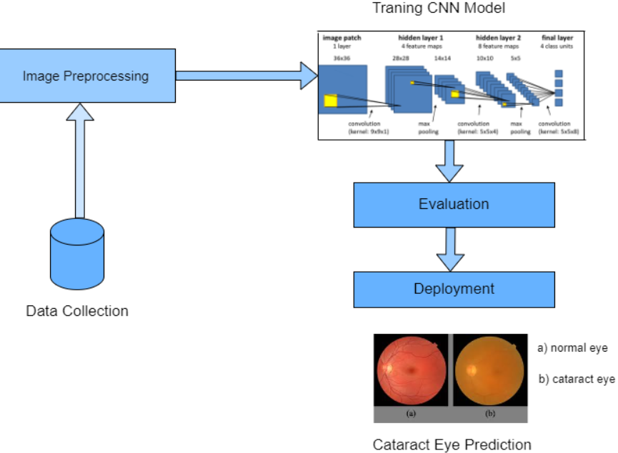
Bangalore Institute of Technology
K.R. Road, V.V. Pura, Bengaluru.-560004.
Department of Information Science & Engineering
Block Diagram

Slide 46
Bangalore Institute of Technology
K.R. Road, V.V. Pura, Bengaluru.-560004.
Department of Information Science & Engineering
Proposed System
Data Collection: Collect a diverse dataset of high-quality, labeled eye images, including both healthy and cataract-affected eyes.
Image Preprocessing: Resize, normalize pixel values, and crop images to relevant regions, ensuring standardized input data for the DenseNet model.
Training: Feed preprocessed images and labels into DenseNet, adjusting parameters to minimize the loss function and teach the model accurate classification.

Slide 47
Bangalore Institute of Technology
K.R. Road, V.V. Pura, Bengaluru.-560004.
Department of Information Science & Engineering
Evaluation: Assess model performance on a separate, unseen test dataset to gauge its generalization to new data.
Deployment: Deploy the trained model in a production environment, integrating it into a system, app, or standalone API. Monitor and update as needed.

Slide 48
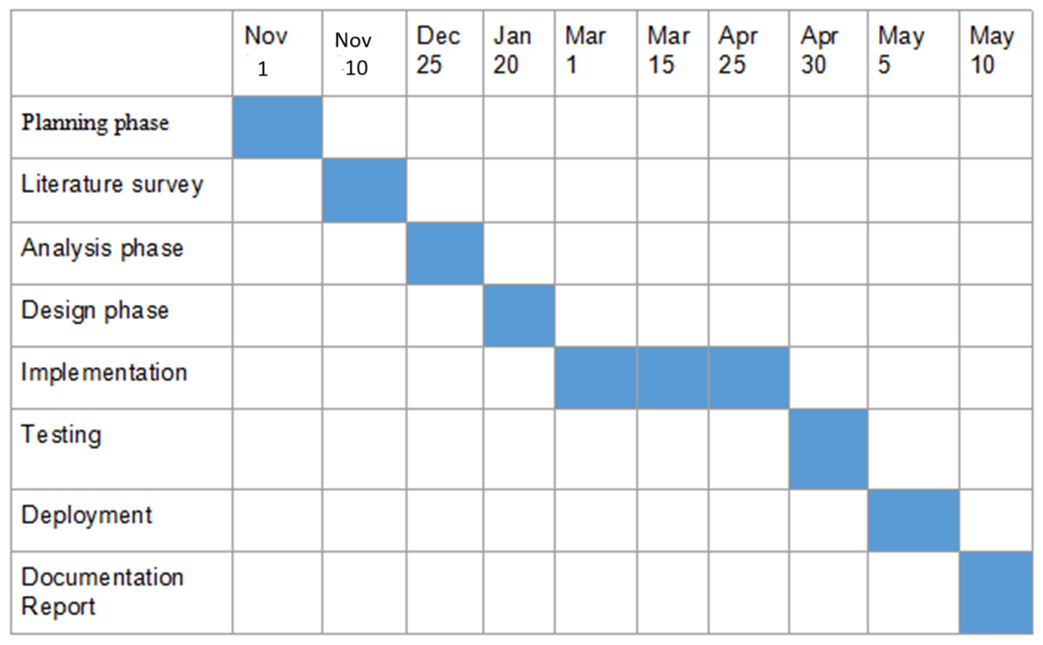
Bangalore Institute of Technology
K.R. Road, V.V. Pura, Bengaluru.-560004.
Department of Information Science & Engineering
PROJECT PLANNING
Gantt Chart

Slide 49
Bangalore Institute of Technology
K.R. Road, V.V. Pura, Bengaluru.-560004.
Department of Information Science & Engineering
Applications
Early Diagnosis and Screening
Telemedicine and Remote Screening
Automation in Ophthalmology Clinics
Postoperative Monitoring
Customized Treatment
Public Health Initiatives
Education and Training

Slide 50
Bangalore Institute of Technology
K.R. Road, V.V. Pura, Bengaluru.-560004.
Department of Information Science & Engineering
REFERENCES
[1] Junayed, M.S., Islam, M., Sadeghzadeh, A., & Rahman, S. (2021). CataractNet: An Automated Cataract Detection System Using Deep Learning for Fundus Images. IEEE Access,
[2] V. Harini & V. Bhanumathi. (2016). Automatic cataract classification system. 2016 International Conference on Communication and Signal Processing (ICCSP), 0815-0819
[3] Shruthi Bhat, Som Mosalagi, Tejal Bhalerao, PushpakKatkar and Rahul Pitale. Cataract Eye Prediction using Machine Learning. International Journal of Computer Applications 176(35):46-48, July 2020.
[4] Sahana M, G. (2019). Identification and Classification of Cataract Stages in Old Age People Using Deep Learning Algorithm. VOLUME-8 ISSUE-10, AUGUST 2019, REGULAR ISSUE.
[5] Weni, I., Utomo, P.E., Hutabarat, B.F., & Alfalah, M. (2021). Detection of Cataract Based on Image Features Using Convolutional Neural Networks. Indonesian Journal of Computing and Cybernetics Systems, 15, 75-86.

Slide 51
Bangalore Institute of Technology
K.R. Road, V.V. Pura, Bengaluru.-560004.
Department of Information Science & Engineering
THANK YOU

